Slide 1
Chapter 10: Image Segmentation
Digital Image Processing

Slide 2
Preview
Segmentation is to subdivide an image into its constituent regions or objects.
Segmentation should stop when the objects of interest in an application have been isolated.

Slide 3
Principal approaches
Segmentation algorithms generally are based on one of 2 basis properties of intensity values
discontinuity : to partition an image based on abrupt changes in intensity (such as edges)
similarity : to partition an image into regions that are similar according to a set of predefined criteria.

Slide 4
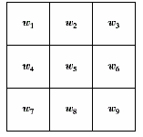
Detection of Discontinuities
detect the three basic types of gray-level discontinuities
points , lines , edges
the common way is to run a mask through the image

Slide 5
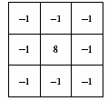
Point Detection
a point has been detected at the location on which the mark is centered if
|R| ≥ T
where
T is a nonnegative threshold
R is the sum of products of the coefficients with the gray levels contained in the region encompassed by the mark.

Slide 6
Point Detection
Note that the mark is the same as the mask of Laplacian Operation (in chapter 3)
The only differences that are considered of interest are those large enough (as determined by T) to be considered isolated points.
|R| ≥ T

Slide 7
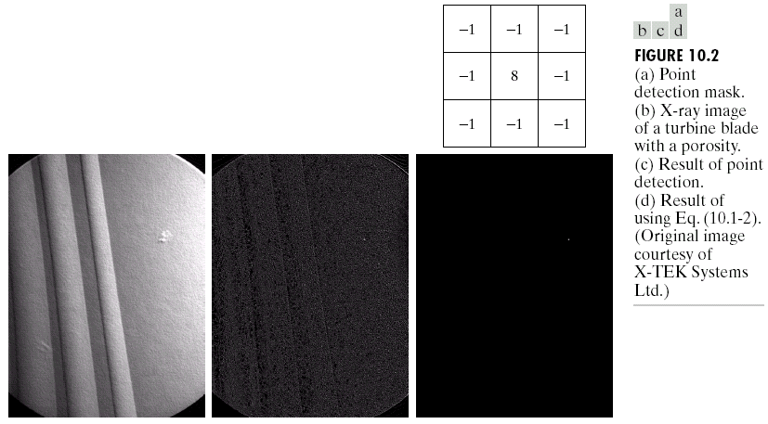
Example

Slide 8
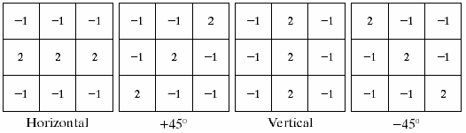
Line Detection
Horizontal mask will result with max response when a line passed through the middle row of the mask with a constant background.
the similar idea is used with other masks.
note: the preferred direction of each mask is weighted with a larger coefficient (i.e.,2) than other possible directions.

Slide 9
Line Detection
Apply every masks on the image
let R1, R2, R3, R4 denotes the response of the horizontal, +45 degree, vertical and -45 degree masks, respectively.
if, at a certain point in the image
|R_{i}| > |R_{j}|,
for all j≠i, that point is said to be more likely associated with a line in the direction of mask i.

Slide 10
Line Detection
Alternatively, if we are interested in detecting all lines in an image in the direction defined by a given mask, we simply run the mask through the image and threshold the absolute value of the result.
The points that are left are the strongest responses, which, for lines one pixel thick, correspond closest to the direction defined by the mask.

Slide 11
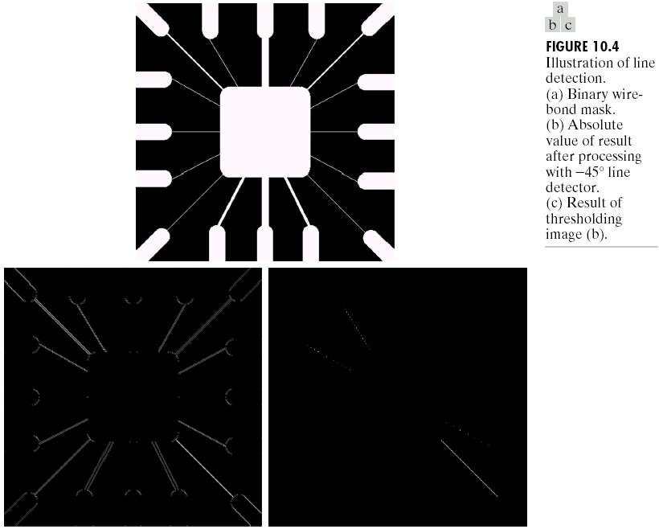
Example

Slide 12
Edge Detection
the most common approach for detecting meaningful discontinuities in gray level.
we discuss approaches for implementing
first-order derivative (Gradient operator)
second-order derivative (Laplacian operator)
Here, we will talk only about their properties for edge detection.
we have introduced both derivatives in chapter 3

Slide 13
Basic Formulation
an edge is a set of connected pixels that lie on the boundary between two regions.
an edge is a “local” concept whereas a region boundary, owing to the way it is defined, is a more global idea.

Slide 14
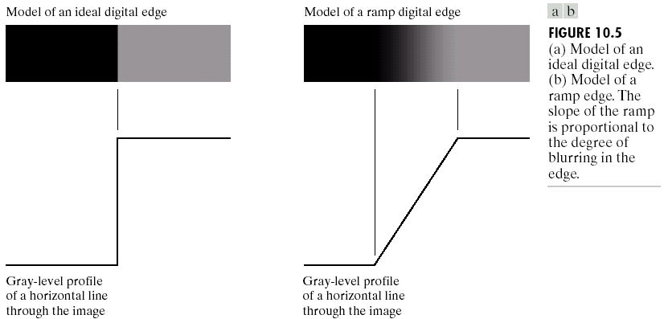
Ideal and Ramp Edges
because of optics, sampling, image acquisition imperfection

Slide 15
Thick edge
The slope of the ramp is inversely proportional to the degree of blurring in the edge.
We no longer have a thin (one pixel thick) path.
Instead, an edge point now is any point contained in the ramp, and an edge would then be a set of such points that are connected.
The thickness is determined by the length of the ramp.
The length is determined by the slope, which is in turn determined by the degree of blurring.
Blurred edges tend to be thick and sharp edges tend to be thin

Slide 16
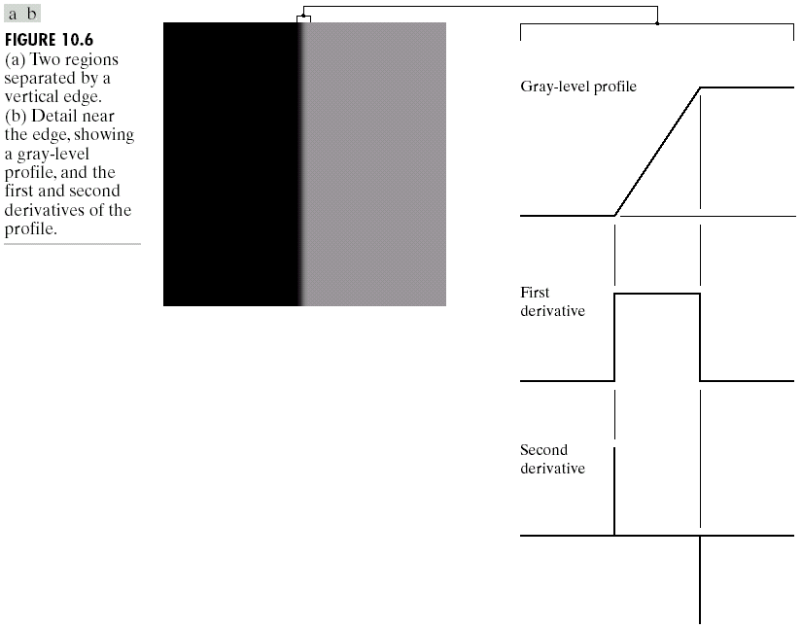
First and Second derivatives
the signs of the derivatives would be reversed for an edge that transitions from light to dark

Slide 17
Second derivatives
produces 2 values for every edge in an image (an undesirable feature)
an imaginary straight line joining the extreme positive and negative values of the second derivative would cross zero near the midpoint of the edge. (zero-crossing property)

Slide 18
Zero-crossing
quite useful for locating the centers of thick edges
we will talk about it again later

Slide 19
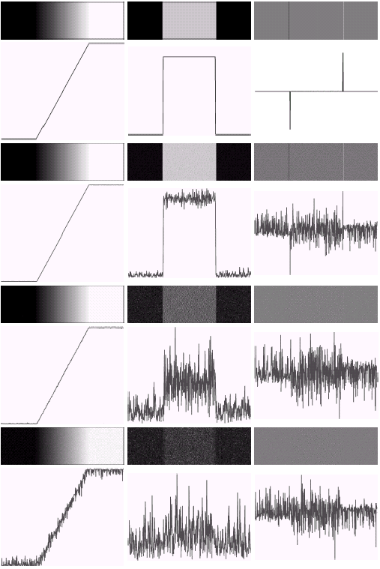
Noise Images
First column: images and gray-level profiles of a ramp edge corrupted by random Gaussian noise of mean 0 and σ = 0.0, 0.1, 1.0 and 10.0, respectively.
Second column: first-derivative images and gray-level profiles.
Third column : second-derivative images and gray-level profiles.

Slide 20
Keep in mind
fairly little noise can have such a significant impact on the two key derivatives used for edge detection in images
image smoothing should be serious consideration prior to the use of derivatives in applications where noise is likely to be present.

Slide 21
Edge point
to determine a point as an edge point
the transition in grey level associated with the point has to be significantly stronger than the background at that point.
use threshold to determine whether a value is “significant” or not.
the point’s two-dimensional first-order derivative must be greater than a specified threshold.

Slide 22
Segmentation Problem
to assemble edge segments into longer edges.
we will talk about it later.

Slide 23
Gradient Operator
first derivatives are implemented using the magnitude of the gradient.
commonly approx.
the magnitude becomes nonlinear

Slide 24
Gradient direction
Let α (x,y) represent the direction angle of the vector ∇f at (x,y)
α (x,y) = tan⁻¹(Gy/Gx)
The direction of an edge at (x,y) is perpendicular to the direction of the gradient vector at that point

Slide 25
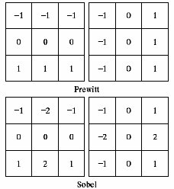
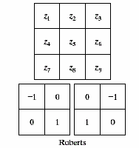
Gradient Masks

Slide 26
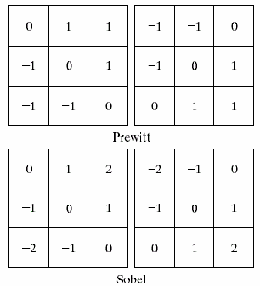
Diagonal edges with Prewitt and Sobel masks
Sobel masks have slightly superior noise-suppression characteristics which is an important issue when dealing with derivatives.

Slide 27
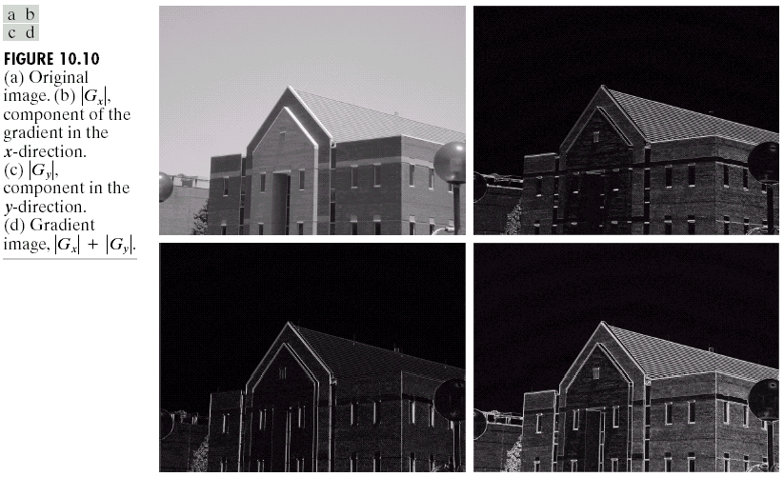
Example

Slide 28
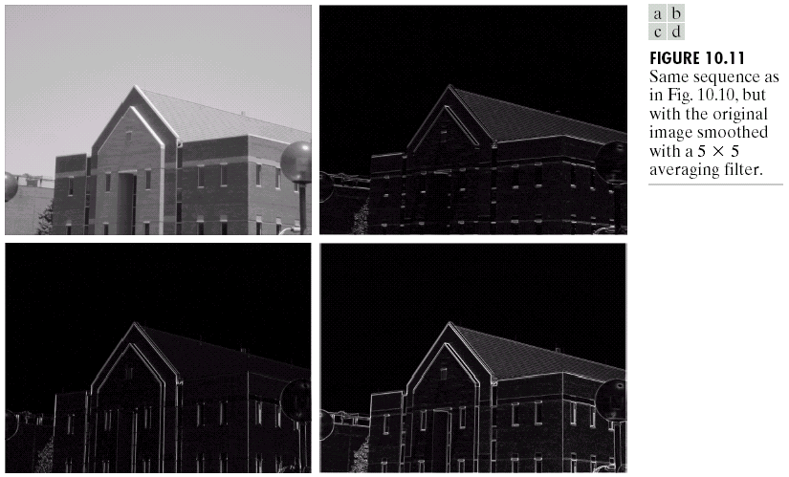
Example

Slide 29
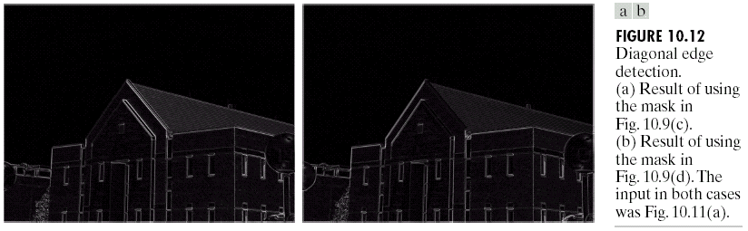
Example

Slide 30
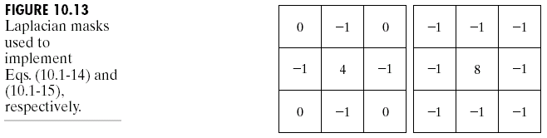
Laplacian
Laplacian operator
(linear operator)

Slide 31
Laplacian of Gaussian
Laplacian combined with smoothing as a precursor to find edges via zero-crossing.
where r² = x²+y², and
σ is the standard deviation

Slide 32
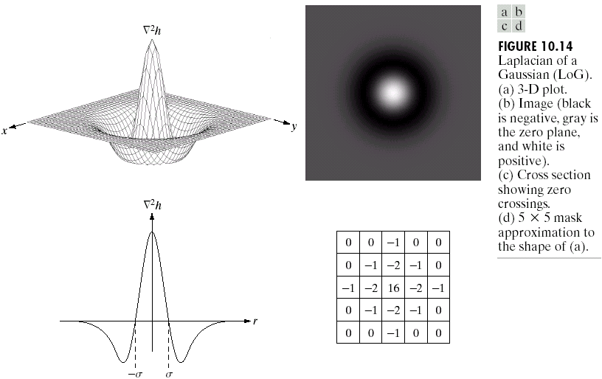
Mexican hat
positive central term
surrounded by an adjacent negative region (a function of distance)
zero outer region
the coefficient must be sum to zero

Slide 33
Linear Operation
second derivation is a linear operation
thus, ∇²f is the same as convolving the image with Gaussian smoothing function first and then computing the Laplacian of the result

Slide 34
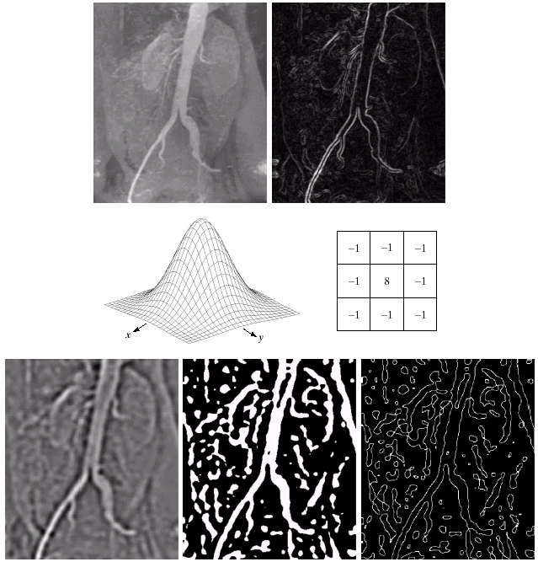
Example
a). Original image
b). Sobel Gradient
c). Spatial Gaussian smoothing function
d). Laplacian mask
e). LoG
f). Threshold LoG
g). Zero crossing

Slide 35
Zero crossing & LoG
Approximate the zero crossing from LoG image
to threshold the LoG image by setting all its positive values to white and all negative values to black.
the zero crossing occur between positive and negative values of the thresholded LoG.

Slide 36
Zero crossing vs. Gradient
Attractive
Zero crossing produces thinner edges
Noise reduction
Drawbacks
Zero crossing creates closed loops. (spaghetti effect)
sophisticated computation.
Gradient is more frequently used.

Slide 37
Edge Linking and Boundary Detection
edge detection algorithm are followed by linking procedures to assemble edge pixels into meaningful edges.
Basic approaches
Local Processing
Global Processing via the Hough Transform
Global Processing via Graph-Theoretic Techniques

Slide 38
Local Processing
analyze the characteristics of pixels in a small neighborhood (say, 3x3, 5x5) about every edge pixels (x,y) in an image.
all points that are similar according to a set of predefined criteria are linked, forming an edge of pixels that share those criteria.

Slide 39
Criteria
the strength of the response of the gradient operator used to produce the edge pixel
an edge pixel with coordinates (x₀,y₀) in a predefined neighborhood of (x,y) is similar in magnitude to the pixel at (x,y) if
|∇f(x,y) - ∇f (x₀,y₀) | ≤ E

Slide 40
Criteria
the direction of the gradient vector
an edge pixel with coordinates (x₀,y₀) in a predefined neighborhood of (x,y) is similar in angle to the pixel at (x,y) if
|α(x,y) - α (x₀,y₀) | < A

Slide 41
Criteria
A point in the predefined neighborhood of (x,y) is linked to the pixel at (x,y) if both magnitude and direction criteria are satified.
the process is repeated at every location in the image
a record must be kept
simply by assigning a different gray level to each set of linked edge pixels.

Slide 42
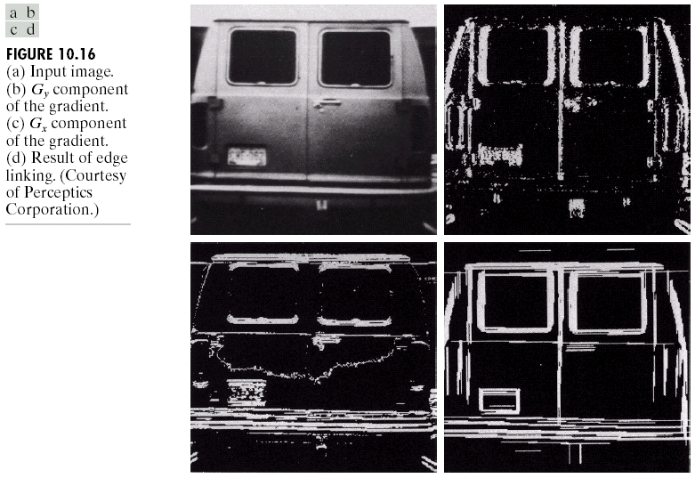
Example
find rectangles whose sizes makes them suitable candidates for license plates
use horizontal and vertical Sobel operators
eliminate isolated short segments
link conditions:
gradient value > 25
gradient direction differs < 15°

Slide 43
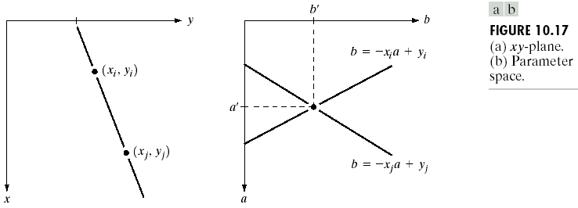
Hough Transformation (Line)
xy-plane
ab-plane or parameter space
y_{i} =ax_{i} + b
b = - ax_{i} + y_{i}
all points (x_{i} ,y_{i}) contained on the same line must have lines in parameter space that intersect at (a’,b’)

Slide 44
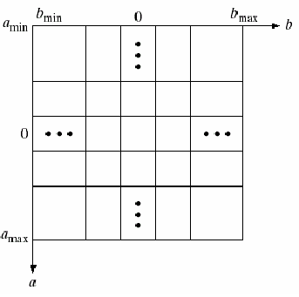
Accumulator cells
(a_{max}, a_{min}) and (b_{max}, b_{min}) are the expected ranges of slope and intercept values.
all are initialized to zero
if a choice of a_{p} results in solution b_{q} then we let A(p,q) = A(p,q)+1
at the end of the procedure, value Q in A(i,j) corresponds to Q points in the xy-plane lying on the line y = a_{i}x+b_{j}
b = - ax_{i} + y_{i}

Slide 45
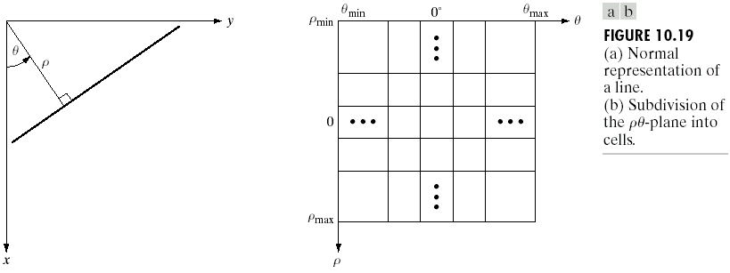
ρθ-plane
ρθ-plane
x cos θ+ y sin θ= ρ
= ±90° measured with respect to x-axis
problem of using equation y = ax + b is that value of a is infinite for a vertical line.
To avoid the problem, use equation x cos θ+ y sin θ = ρ to represent a line instead.
vertical line has θ = 90° with ρ equals to the positive y-intercept or θ = -90° with ρ equals to the negative y-intercept

Slide 46
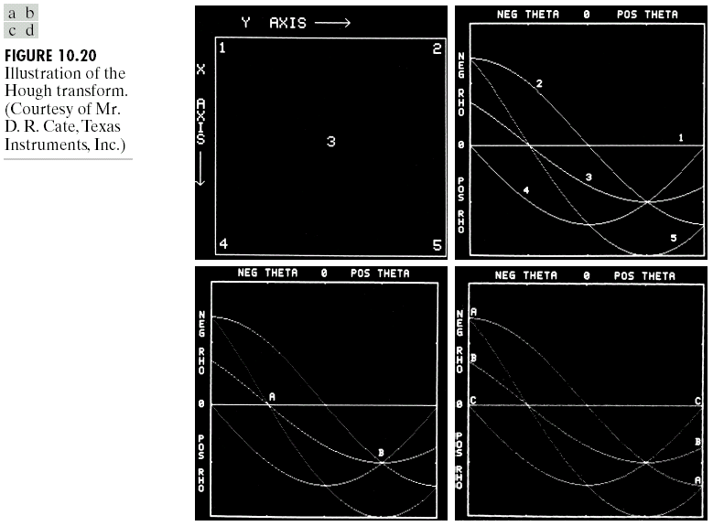
where D is the distance between corners in the image

Slide 47
Generalized Hough Transformation
can be used for any function of the form
g(v,c) = 0
v is a vector of coordinates
c is a vector of coefficients

Slide 48
Hough Transformation (Circle)
equation:
(x-c₁)² + (y-c₂)² = c₃²
three parameters (c₁, c₂, c₃)
cube like cells
accumulators of the form A(i, j, k)
increment c₁ and c₂ , solve of c₃ that satisfies the equation
update the accumulator corresponding to the cell associated with triplet (c₁, c₂, c₃)

Slide 49
Edge-linking based on Hough Transformation
Compute the gradient of an image and threshold it to obtain a binary image.
Specify subdivisions in the ρθ-plane.
Examine the counts of the accumulator cells for high pixel concentrations.
Examine the relationship (principally for continuity) between pixels in a chosen cell.

Slide 50
Continuity
based on computing the distance between disconnected pixels identified during traversal of the set of pixels corresponding to a given accumulator cell.
a gap at any point is significant if the distance between that point and its closet neighbor exceeds a certain threshold.

Slide 51
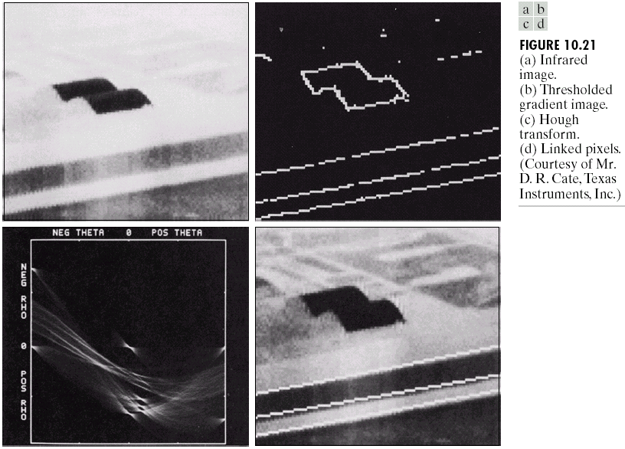
link criteria:
1). the pixels belonged to one of the set of pixels linked according to the highest count
2). no gaps were longer than 5 pixels

Slide 52
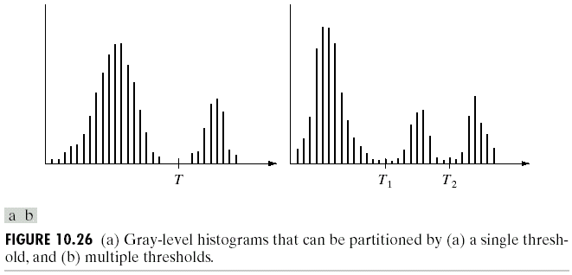
Thresholding
image with dark background and a light object
image with dark background and two light objects

Slide 53
Multilevel thresholding
a point (x,y) belongs to
to an object class if T₁ < f(x,y) ≤ T₂
to another object class if f(x,y) > T₂
to background if f(x,y) ≤ T₁
T depends on
only f(x,y) : only on gray-level values  Global threshold
both f(x,y) and p(x,y) : on gray-level values and its neighbors  Local threshold

Slide 54
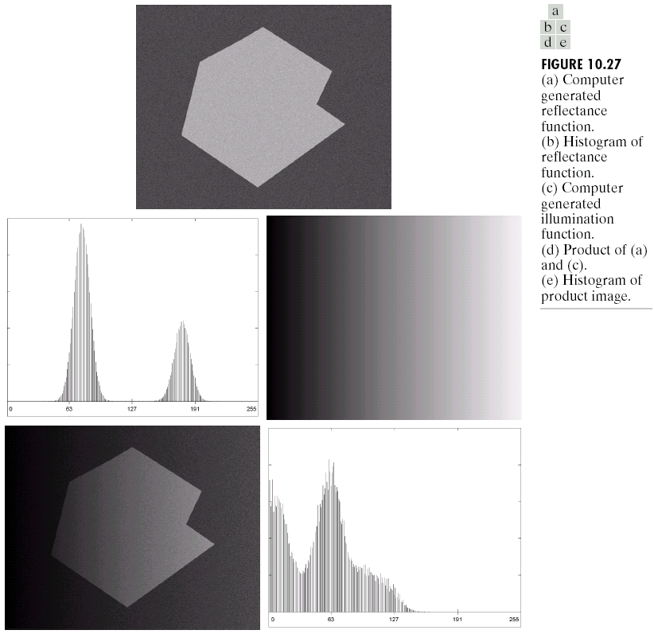
The Role of Illumination
easily use global thresholding
object and background are separated
f(x,y) = i(x,y) r(x,y)
a). computer generated reflectance function
b). histogram of reflectance function
c). computer generated illumination function (poor)
d). product of a). and c).
e). histogram of product image
difficult to segment

Slide 55
Illumination compensation
compensate nonuniformity by projecting the illumination pattern onto a constant, white reflective surface.
thus,
g(x,y) = ki(x,y)
where k is a constant that depends on the surface and i(x,y) is the illumination pattern

Slide 56
Illumination compensation
for any image f(x,y) = i(x,y) r(x,y) obtained with the same illumination function
simply dividing f(x,y) by g(x,y)
yields a normalized function h(x,y)
h(x,y) = f(x,y)/g(x,y) = r(x,y)/k
thus, we can use a single threshold T/k to segment h(x,y)

Slide 57
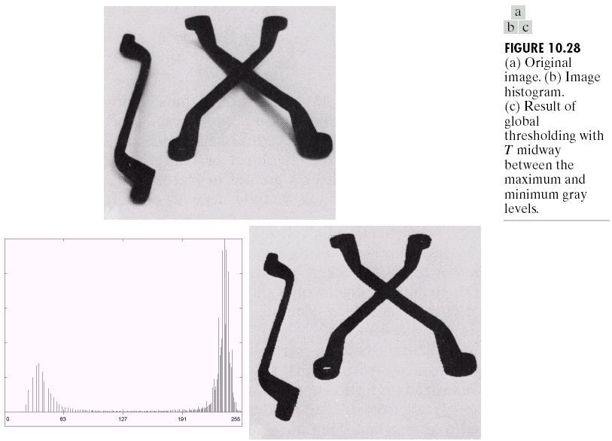
Basic Global Thresholding
use T midway between the max and min gray levels
generate binary image

Slide 58
Basic Global Thresholding
based on visual inspection of histogram
Select an initial estimate for T.
Segment the image using T. This will produce two groups of pixels: G₁ consisting of all pixels with gray level values > T and G₂ consisting of pixels with gray level values ≤ T
Compute the average gray level values μ₁ and μ₂ for the pixels in regions G₁ and G₂
Compute a new threshold value
T = 0.5 (μ₁ + μ₂)
Repeat steps 2 through 4 until the difference in T in successive iterations is smaller than a predefined parameter T_{o}.

Slide 59
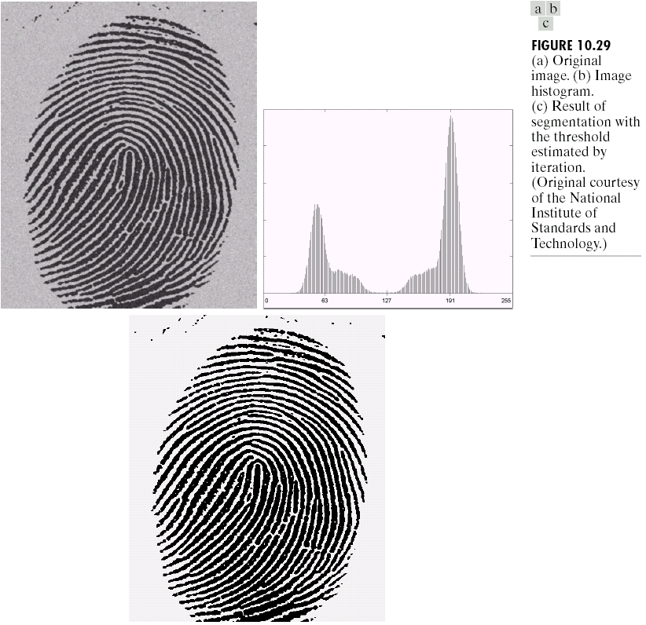
Example: Heuristic method
note: the clear valley of the histogram and the effective of the segmentation between object and background
T₀ = 0
3 iterations
with result T = 125

Slide 60
Basic Adaptive Thresholding
subdivide original image into small areas.
utilize a different threshold to segment each subimages.
since the threshold used for each pixel depends on the location of the pixel in terms of the subimages, this type of thresholding is adaptive.

Slide 61
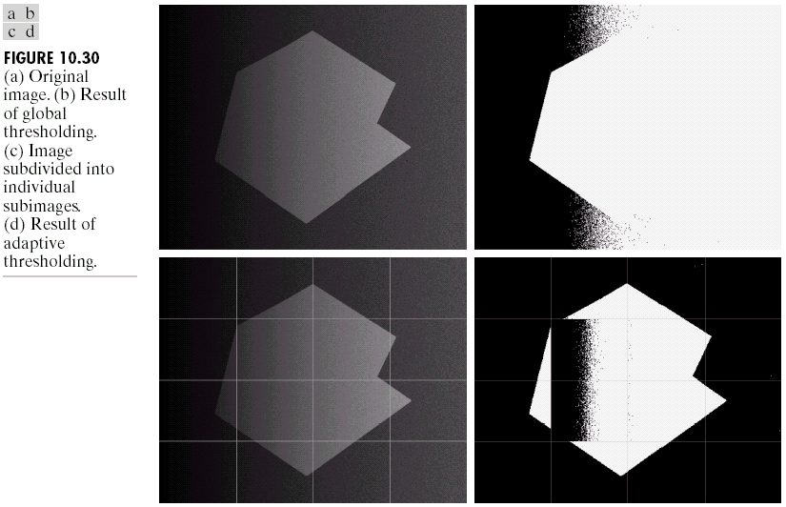
Example : Adaptive Thresholding

Slide 62
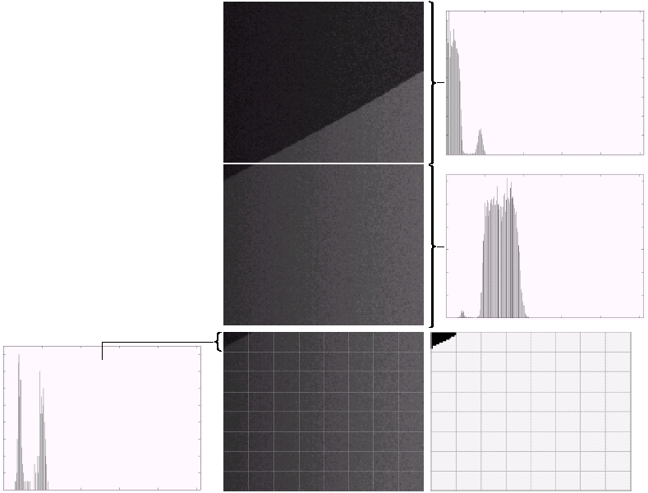
Further subdivision
a). Properly and improperly segmented subimages from previous example
b)-c). corresponding histograms
d). further subdivision of the improperly segmented subimage.
e). histogram of small subimage at top
f). result of adaptively segmenting d).

Slide 63
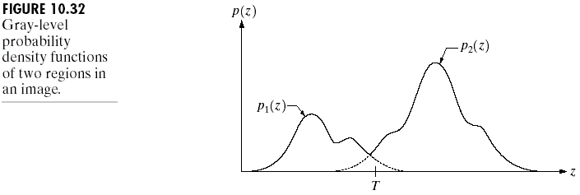
Optimal Global and Adaptive Thresholding

Slide 64
Probability of erroneously

Slide 65
Minimum error
Differentiating E(T) with respect to T (using Leibniz’s rule) and equating the result to 0
if P₁ = P₂ then
the optimum threshold
is where the curve
p₁(z) and p₂(z) intersect
find T which makes

Slide 66
Gaussian density
Example: use PDF = Gaussian density : p₁(z) and p₂(z)
where
μ₁ and σ₁² are the mean and variance of the Gaussian density of one object
μ₂ and σ₂² are the mean and variance of the Gaussian density of the other object

Slide 67
Quadratic equation
if P₁ = P₂ or σ = 0 then the optimal threshold is the average of the means

Slide 68
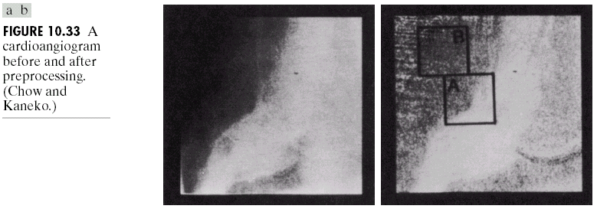
Example

Slide 69
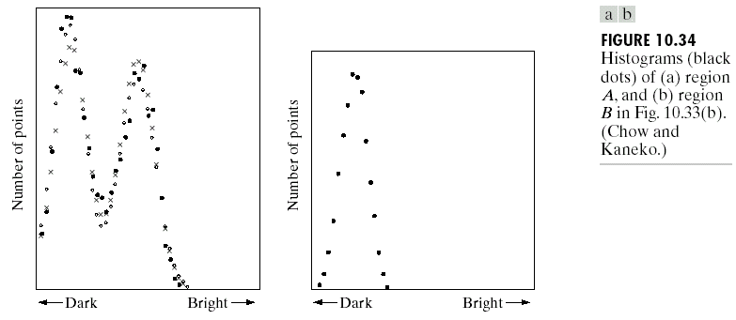
Histogram of the example

Slide 70
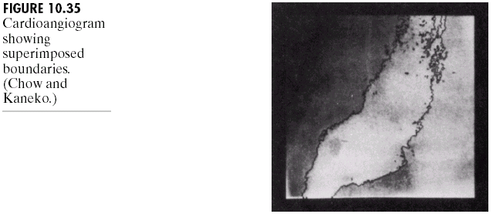
Example: Boundary superimposed

Slide 71
Boundary Characteristic for Histogram Improvement and Local Thresholding
light object of dark background
local processing due to using gradient of each small area
(…)(-,+)(0 or +)(+,-)(…)
all pixels that are not on an edge are labeled 0
all pixels that are on the dark side of an edge are labeled +
all pixels that are on the light side an edge are labeled -

Slide 72
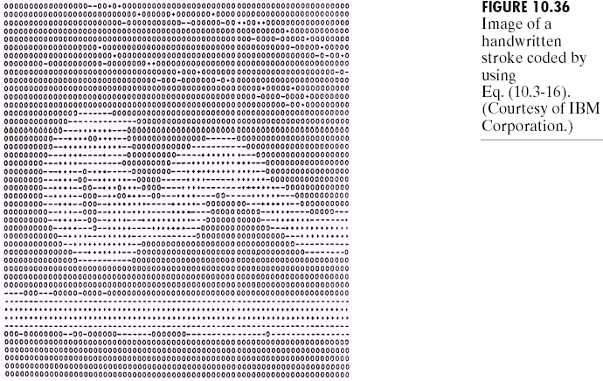
Example

Slide 73
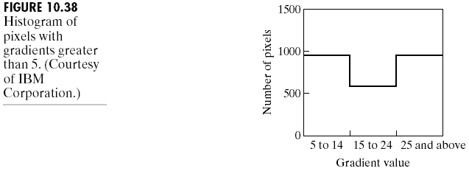
Histogram of Gradient
select T at the midpoint of the valley

Slide 74
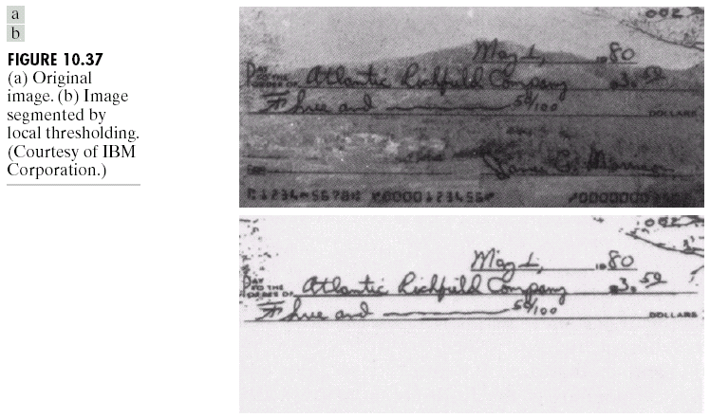
Result of applying T

Slide 75
Region-Based Segmentation
Basic Formulation
P(R_{i}) is a logical predicate property defined over the points in set R_{i}
ex. P(R_{i}) = TRUE if all pixel in R_{i} have the same gray level

Slide 76
Region Growing
start with a set of “seed” points
growing by appending to each seed those neighbors that have similar properties such as specific ranges of gray level

Slide 77
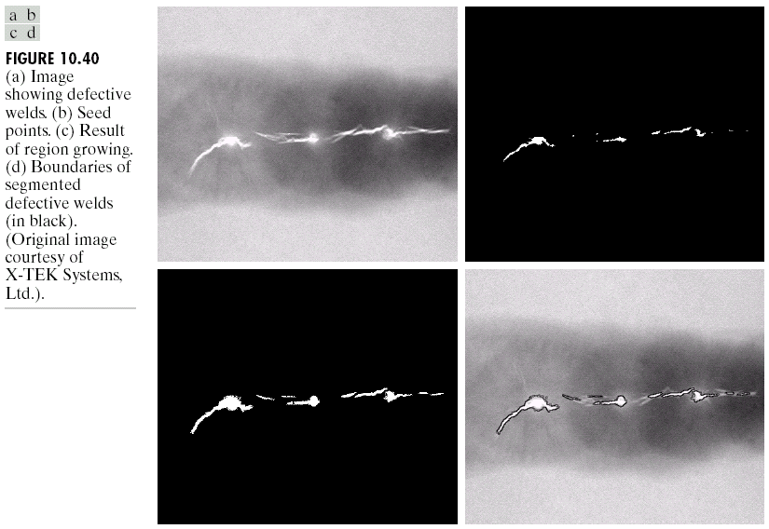
Region Growing
select all seed points with gray level 255
criteria:
the absolute gray-level difference between any pixel and the seed has to be less than 65
the pixel has to be 8-connected to at least one pixel in that region (if more, the regions are merged)

Slide 78
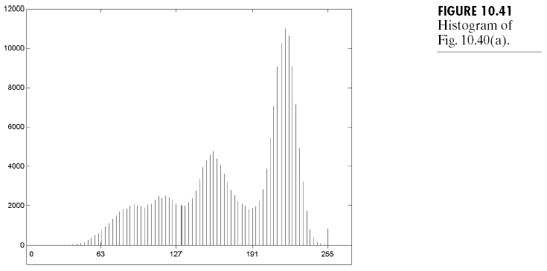
Histogram of fig 10.40 a)
used to find the criteria of the difference gray-level between each pixels and the seeds

Slide 79
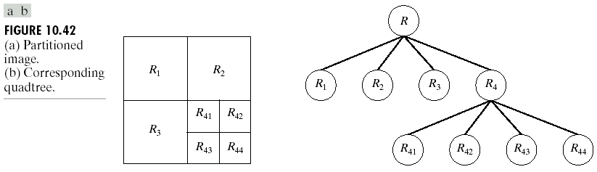
Region splitting and merging
Quadtree
Split into 4 disjoint quadrants any region R_{i} for which P(R_{i}) = FALSE
Merge any adjacent region R_{j} and R_{k} for which P(R_{i} ∪ R_{k} ) = TRUE
Stop when no further merging or splitting is possible.

Slide 80
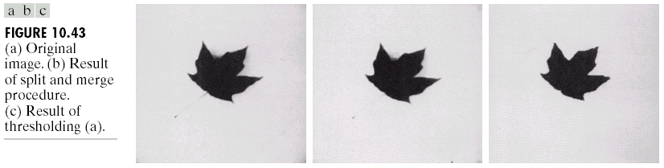
Example
P(R_{i}) = TRUE if at least 80% of the pixels in R_{i} have the property |z_{j}-m_{i}| ≤ 2σ_{i},
where
z_{j} is the gray level of the j^{th} pixel in R_{i}
m_{i} is the mean gray level of that region
σ_{i} is the standard deviation of the gray levels in R_{i}

Slide 81
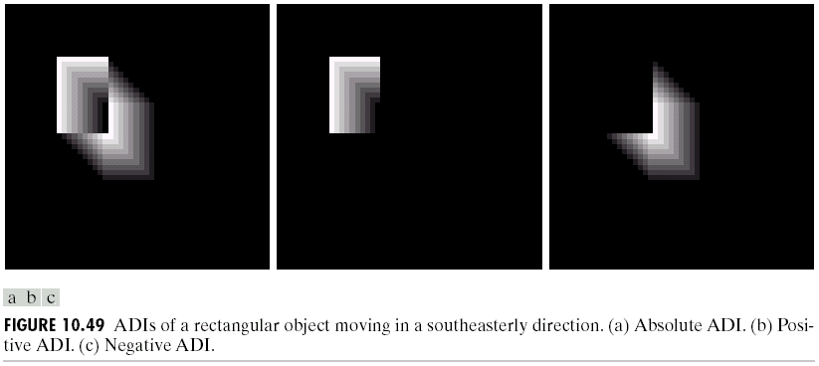

Slide 82
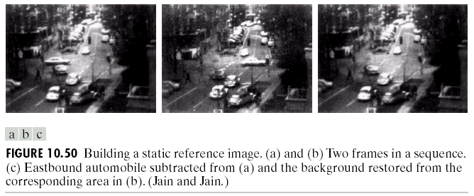

Slide 83
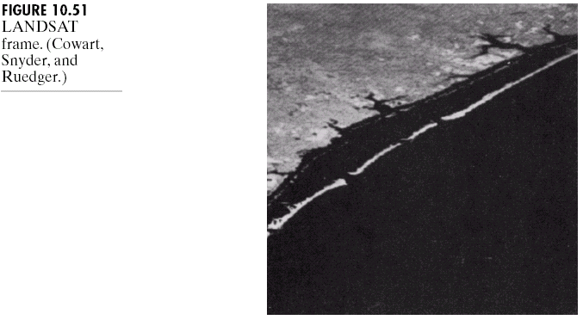

Slide 84
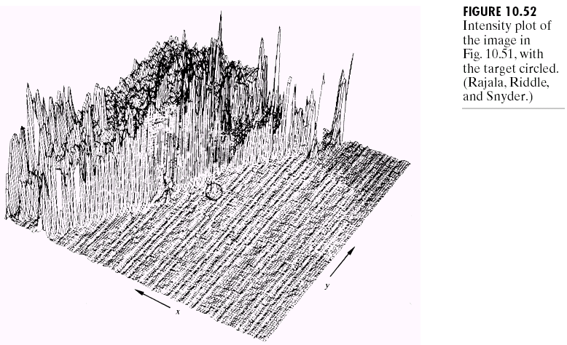

Slide 85
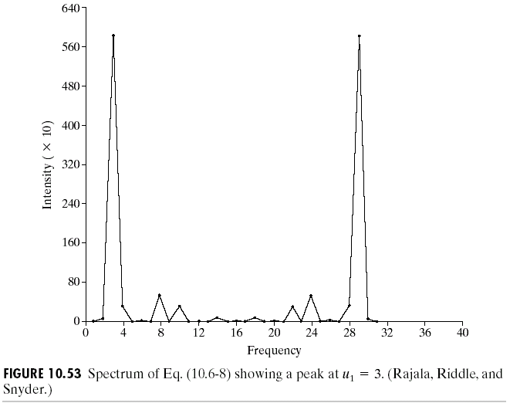

Slide 86
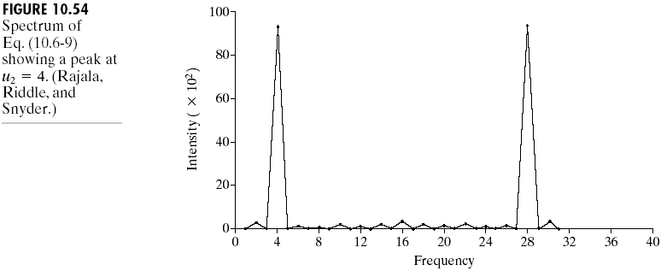

Slide 87
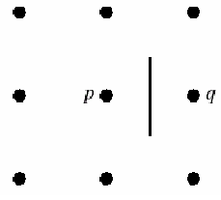
Global Processing via Graph-Theoretic Techniques
searching graph for low-cost paths that correspond to significant edges
performs well in the presence of noise.
time consuming process.

Slide 88
Basic Definition
Graph G = (N,U) is a finite, nonempty set of nodes N, together with a set U of unordered pairs of distinct elements of N.

Slide 89
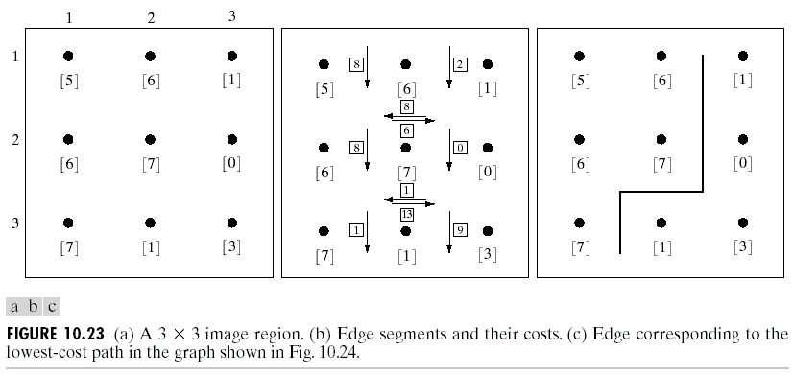

Slide 90
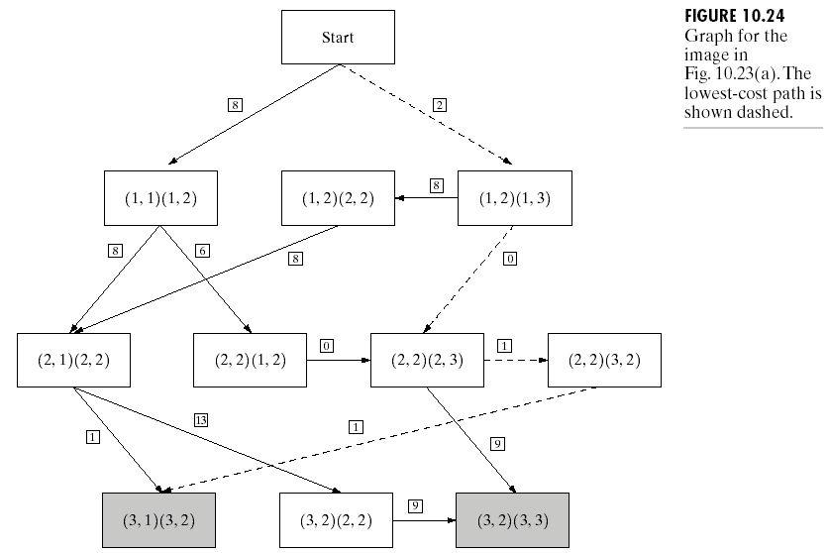

Slide 91
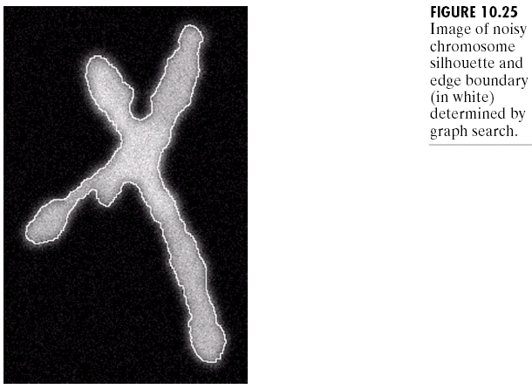

Slide 92

Thresholds based on several variables (multispectral thresholding)

